Slide 1
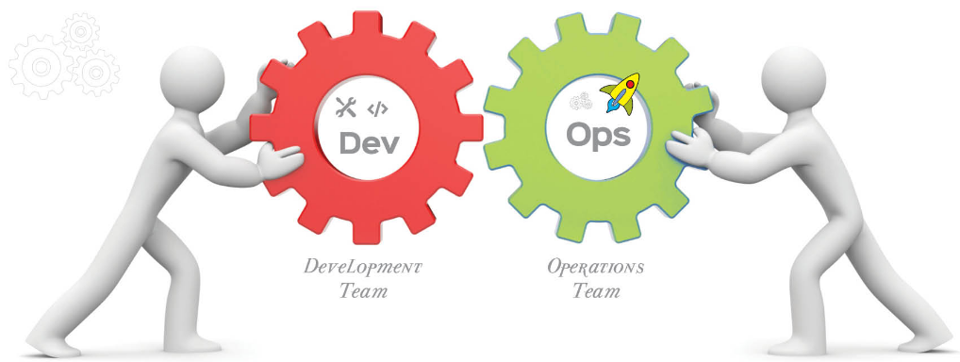
DevOps

Slide 2
Software Engineering
"The application of a systematic, disciplined, quantifiable approach to the development, operation, and maintenance of software“
-- IEEE

Slide 3
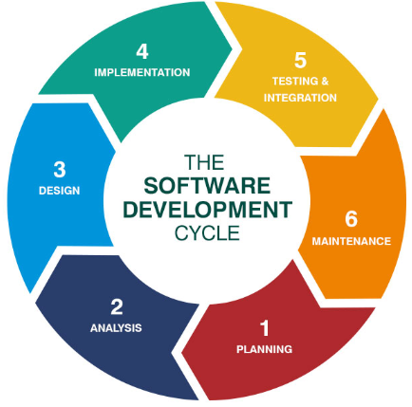

Slide 4
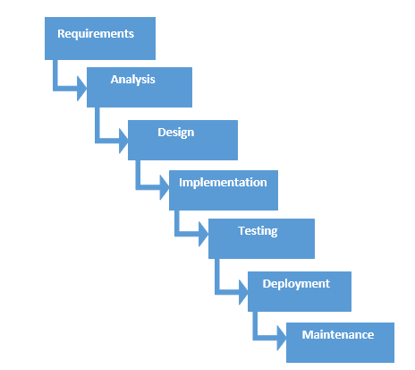
Traditional Waterfall Model

Slide 5
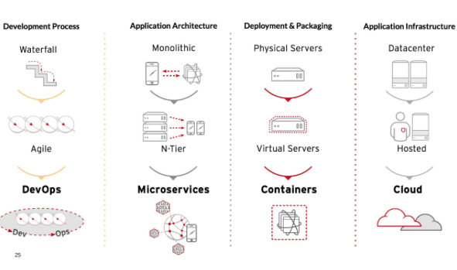

Evolution of IT

Slide 6
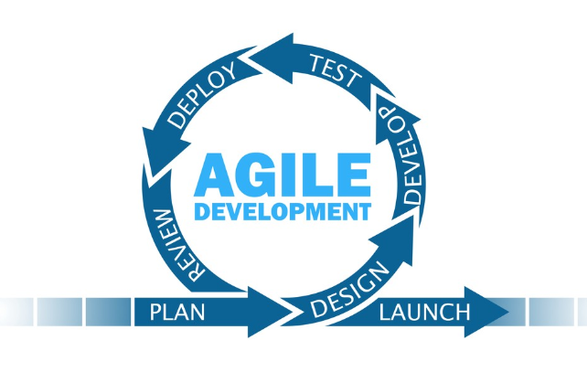

Slide 7
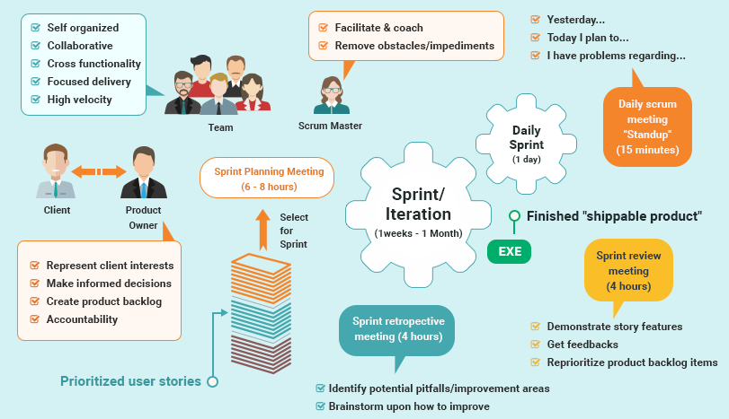

Slide 8
Evolution of IT

Slide 9
Challenges:
Infrastructure Readiness
Scalability
Quality of the Product
Limited Release windows – Releases may slip/fail

Slide 10
What is the Need ???
Shorter Deployment Cycles, Faster Innovation
Reduced Deployment Failures, Rollbacks, and Time to Recover
Improved Communication and Collaboration
Increased Efficiencies

Slide 11
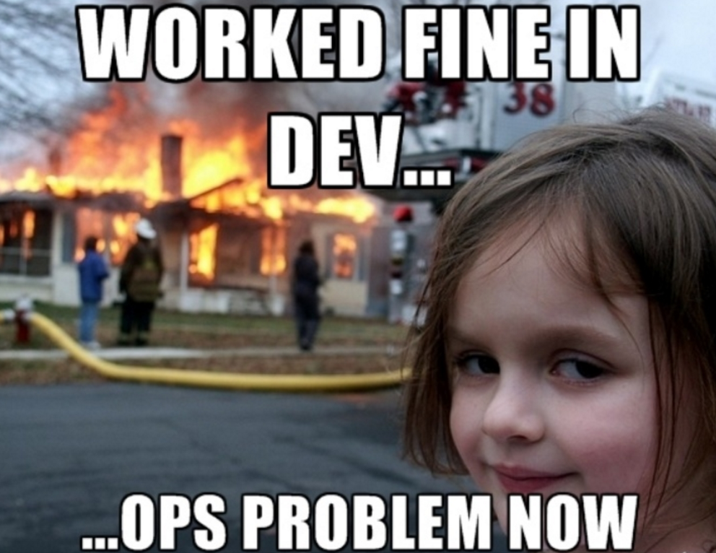

Slide 12
Evolution of IT
Notes:
This is what the new Compute Model looks like
Were going to focus on Agile & DevOps today
But a big influencer and enabler of this is the push to the Cloud
So let’s take a quick look at what the Army CIO says about Cloud

Slide 13
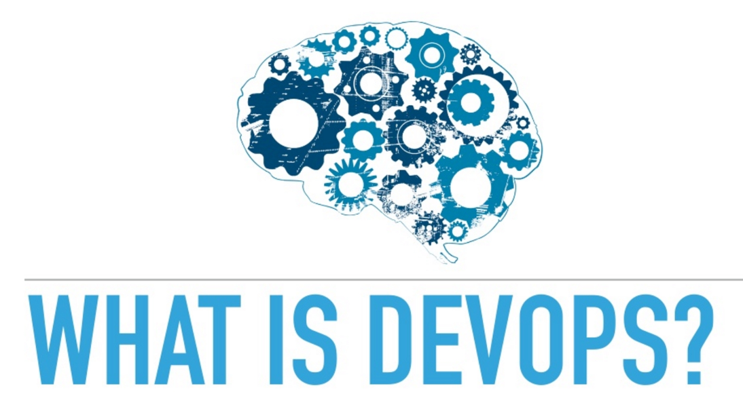

Slide 14
Is it a culture?
Is it a job title?
Is it a team?
Is it a way of organizing?
Is it a tool stack?
Or just a way of thinking?

Slide 15
“DevOps is a re-org,
not a new team to hire”
-- Adrian Cockcroft

Slide 16
Definition…….
“DevOps is agile IT operations delivery, required to match the cadence of agile IT development”.
“DevOps is the philosophy of unifying Development and Operations at the culture, practice, and tool levels, to achieve accelerated and more frequent deployment of changes to Production (The IT Sceptic)”.
DevOps is a software Engineering Culture and Practice that is unifying Software Development and Software Operations. It Aims at Shorter Deployment cycles, More dependable releases in close alignment with business objectives.

Slide 17
Continues…
DevOps is first a Culture of Collaboration between developers and Operations.
The culture has given scope for set of practices.
DevOps is a revolutionary movement by Practitioners , for practitioners.

Slide 18
History
DevOps and Agile often go hand in hand. It can be difficult to do Agile without DevOps, and it can be difficult to do DevOps without Agile.
In 2007, Patrick Debois was an engineer who had experience in the industry, doing both development and operations work. He was working on quality assurance testing on a particular project and became frustrated with all of the problems caused by the divide between dev and ops. As a tester, he was constantly going back and forth between them, and saw that there were many issues getting in the way of releasing software quickly while maintaining stability.

Slide 19
In 2008, Patrick Debois met Andrew Shafer at the Agile 2008 conference in Toronto, Canada, and they began to start conversations about this divide between development in operations and how to close the gap. They began to look for other people who were interested in bridging that divide and began to start online discussion groups to talk about this problem. On June 23rd, 2009, there was a famous talk given by John Allspaw and Paul Hammond at the Velocity Conference called 10 Plus Deploys Per Day Dev and Ops Cooperation at Flicker. They were doing an extremely large number of deployments every day, and they had pioneered some ways to do that through cooperation between development and operations. Now Patrick Dubois was watching this talk via live stream, and it started a huge discussion on Twitter. On October 30th through the 31st, 2009, Patrick hosted an event called DevOps Days in Ghent, Belgium. This was a small conference for both developers and operations engineers, and it spawned a continued conversation on Twitter with the hashtag Dev0ps.

Slide 20
This collaboration between developers and operations people has led to the creation of many different tools that support the practices valued by DevOps. Since 2009, the DevOps movement has not stopped growing.
The companies that are growing the most, the companies that are the most successful today in the IT industry are companies that are doing and pioneering DevOps.

Slide 21
Goals…
The goal of the development team is to deliver features into the hands of the customer as quickly as possible, so their goal is speed. But the goal of the operations team is to maintain the stability of the system and minimize downtime.
stability and speed of delivery
Time-to-market
Few Production Failures
Immediate recovery from failures.
There is no wall in a DevOps culture.

Slide 22
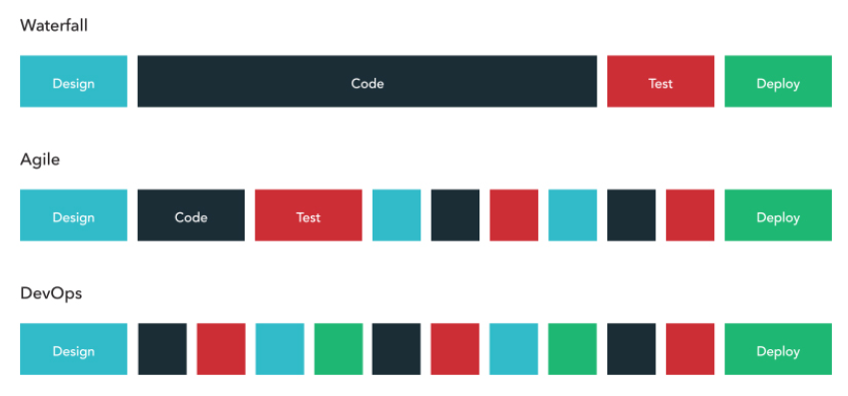

Slide 23
